Slide 1
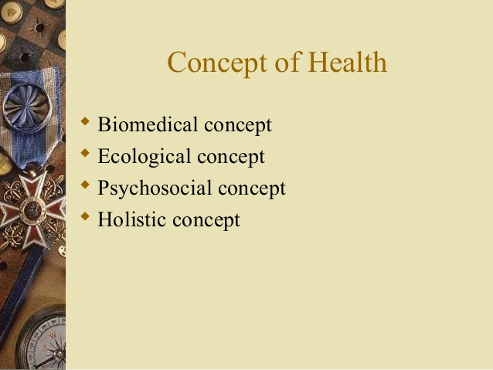

Slide 2
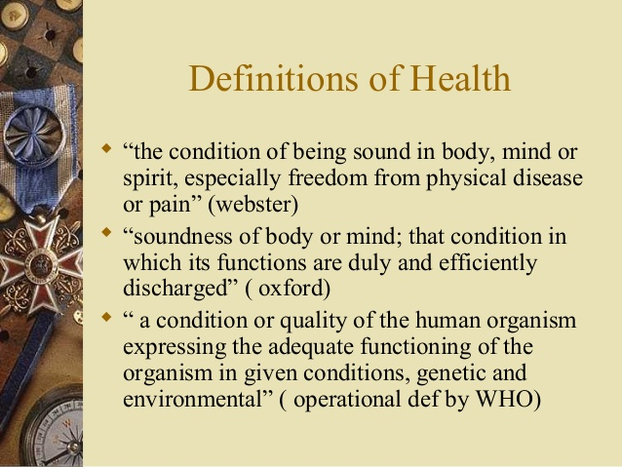

Slide 3
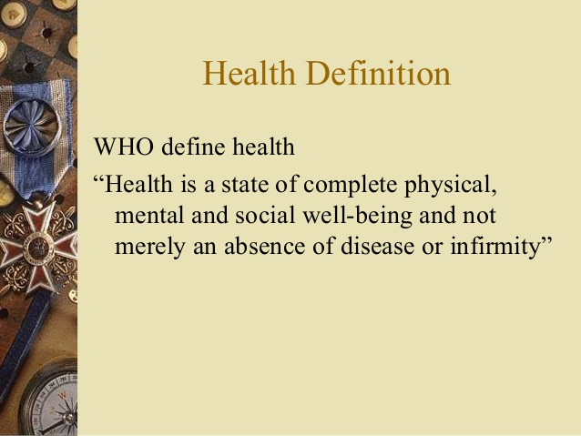

Slide 4
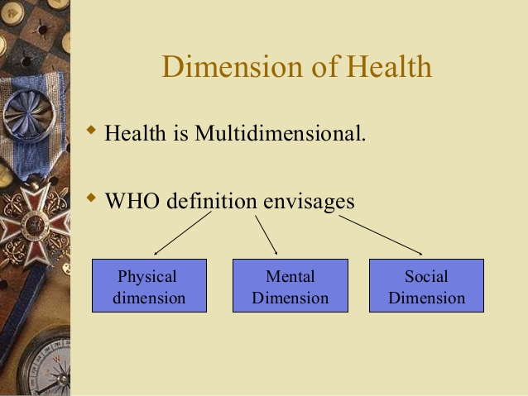

Slide 5
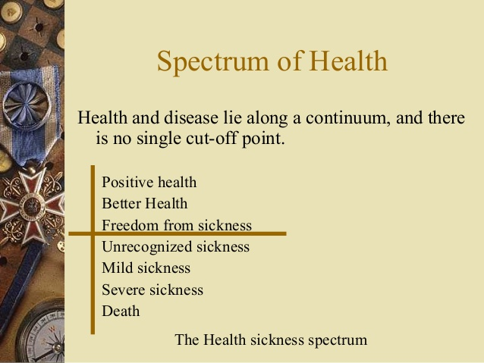
Notes:
What do u think determines health?

Slide 6


Slide 7


Slide 8
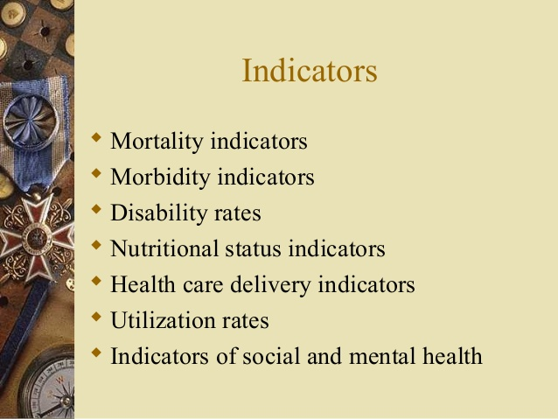

Slide 9
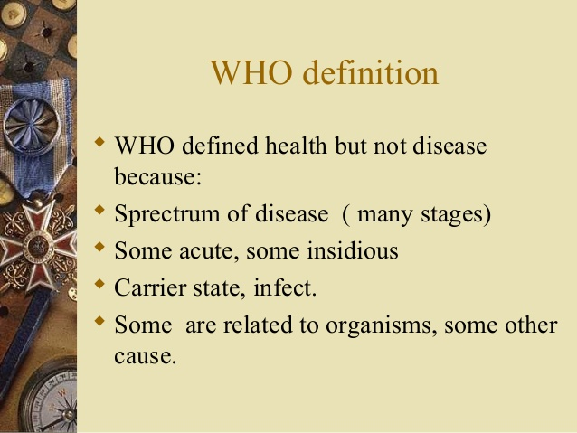

Slide 10
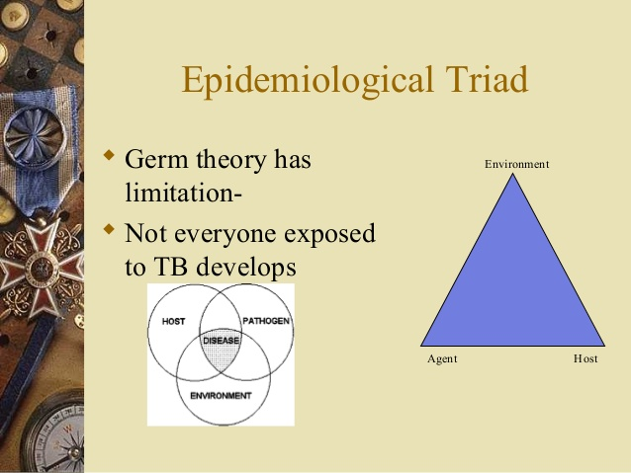

Slide 11
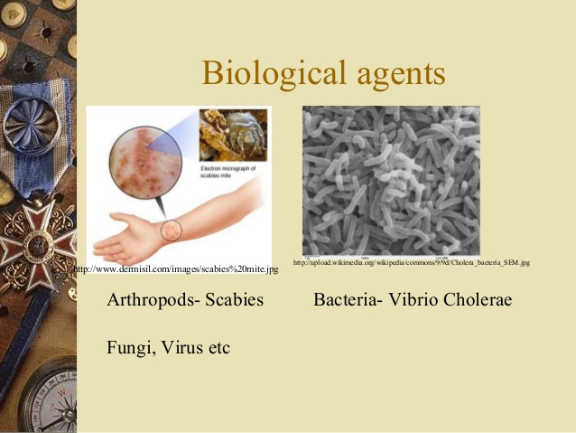

Slide 12
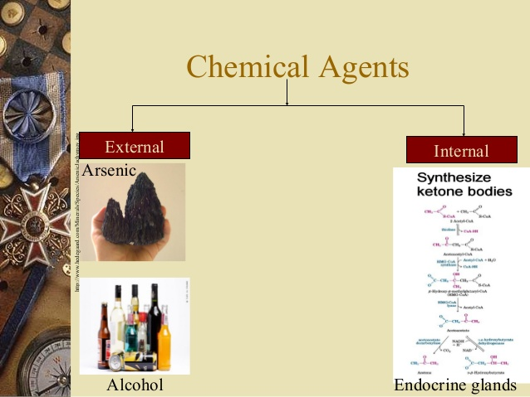

Slide 13
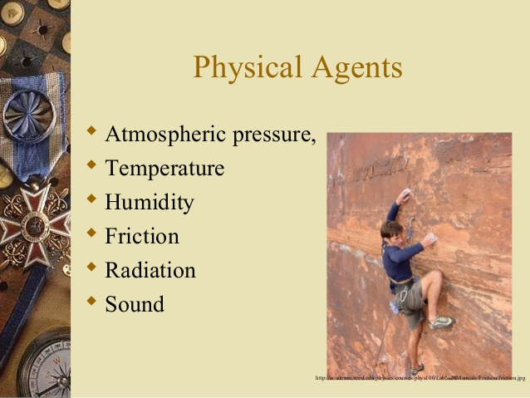

Slide 14
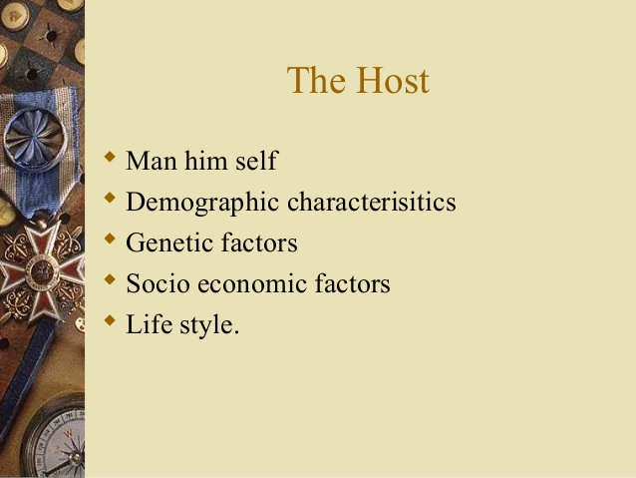

Slide 15
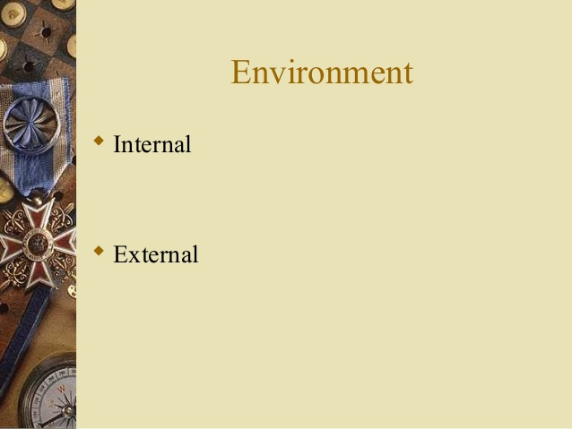

Slide 16
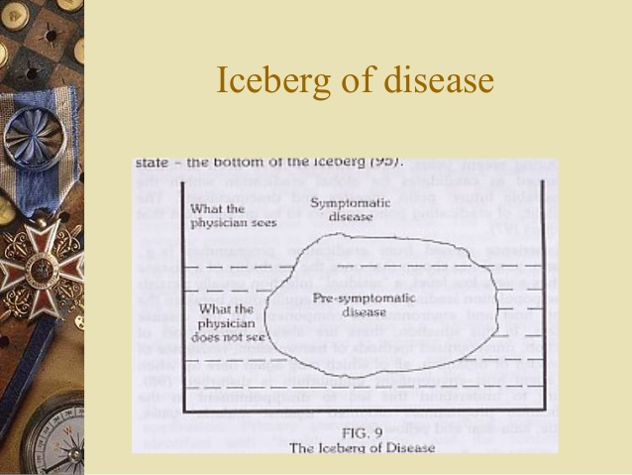

Slide 17
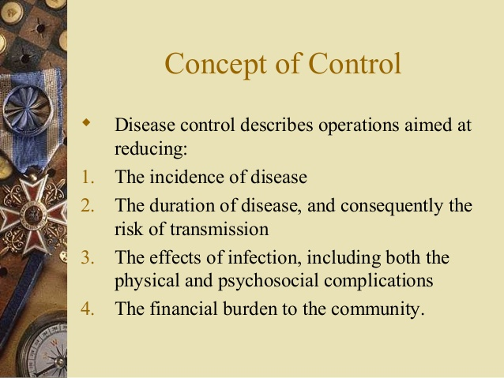

Slide 18
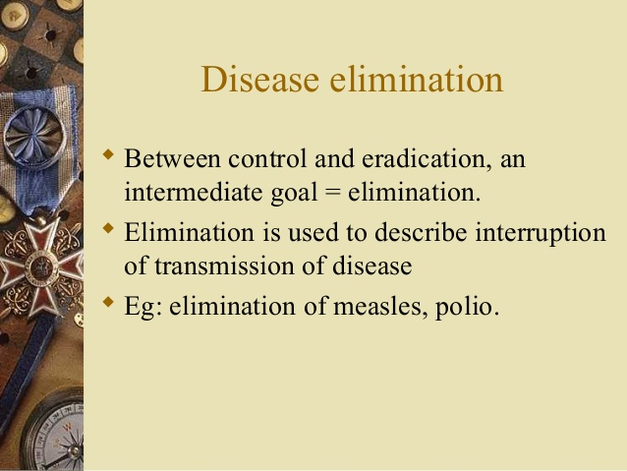

Slide 19
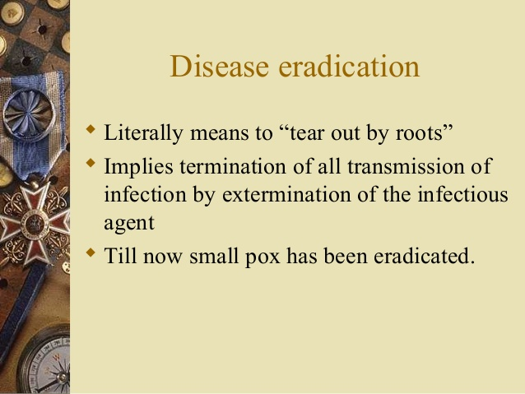

Slide 20
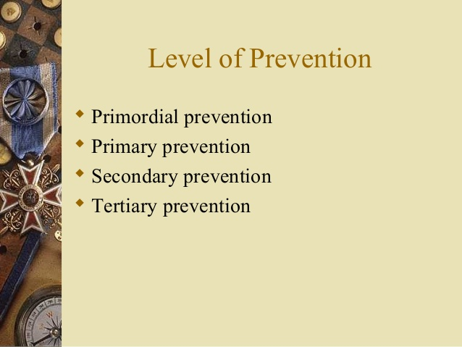

Slide 21
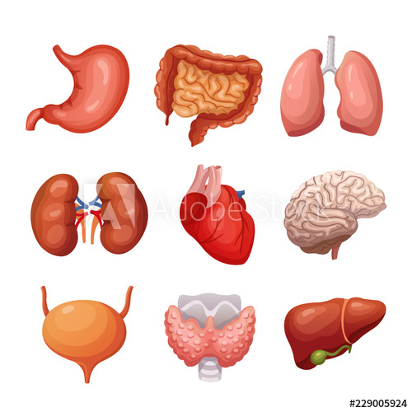

Slide 22
GENERAL ANATOMY
Anatomy = Ana (Gr) Tome (Gr)
Apart To Cut
Dissection = Dissecare (Latin)
To cut apart

Slide 23
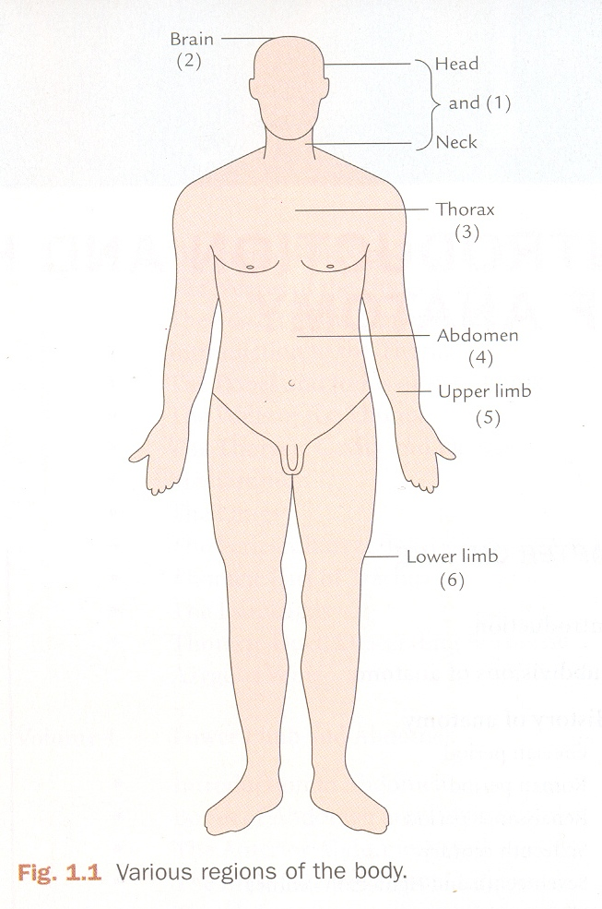
SUB – DIVISIONS OF BODY
Head and Neck
Brain
Superior Extremity
Thorax
Abdomen and Pelvis
Inferior Extremity

Slide 24
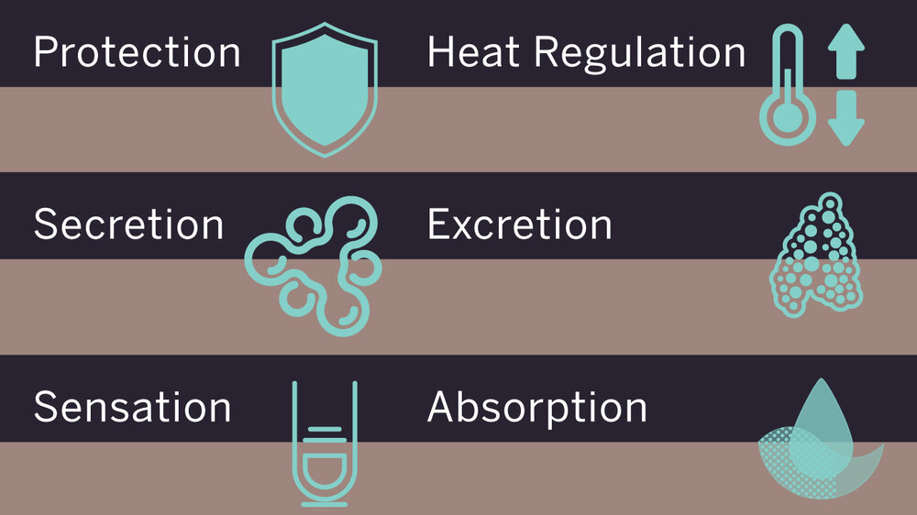
INTEGUMENTARY SYSTEM
Consists of the skin, hair, nails
Skin is the largest organ of the body

Slide 25
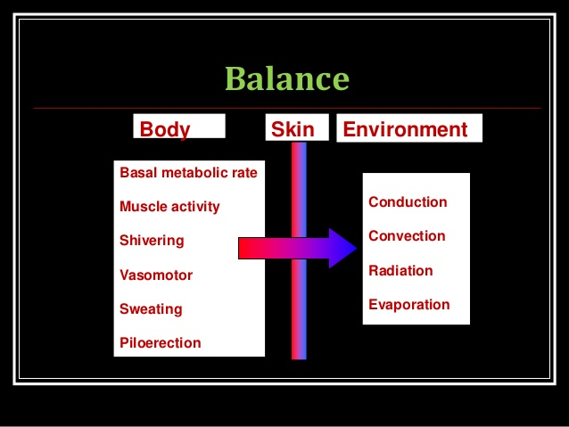

Slide 26
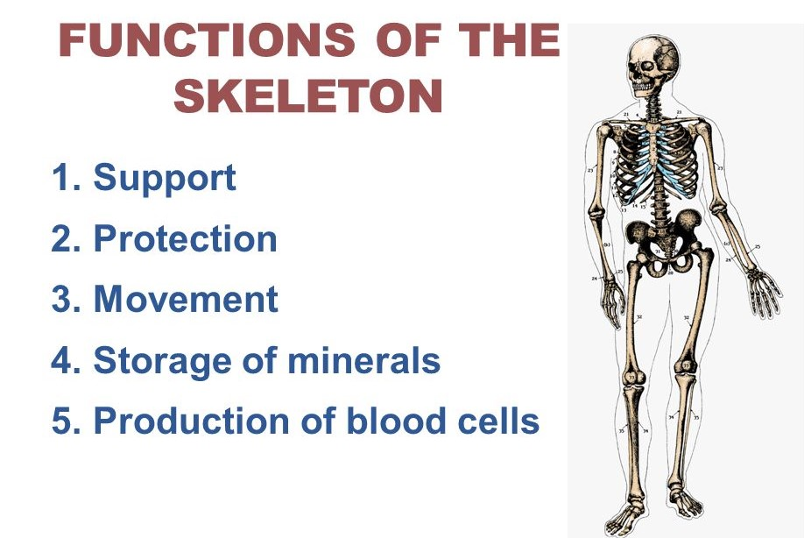
SKELETAL SYSTEM
Includes all of the bones and joints in the body
The skeleton provides support and protection for the soft tissues that make up the rest of the body.

Slide 27
Bones lose strength over time. Keeping them strong requires eating calcium-rich foods like dairy products, broccoli, and some fish.
Females must include calcium rich foods in their diet as it safeguards against osteoporosis ( brittleness of bones making them more vulnerable to fractures).
So do take good care of your birth giver MOM !!! & see to it that she includes calcium and iron rich diet .

Slide 28
MUSCULAR SYSTEM
The muscular system is composed of specialized cells called muscle fibres.
Their predominant function is contractibility. Muscles, attached to bones or present as a part of internal organs and blood vessels, are responsible for different movement as per specialized function.
Nearly all movement in the body is the result of muscle contraction.

Slide 29
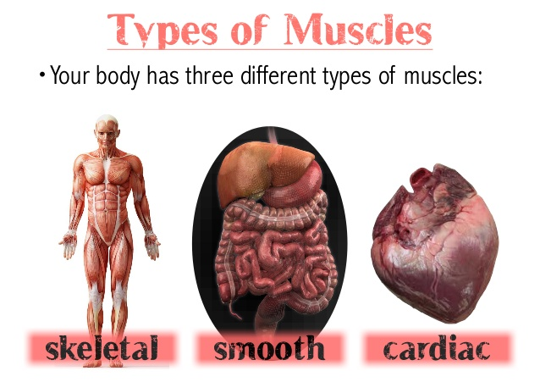

Slide 30
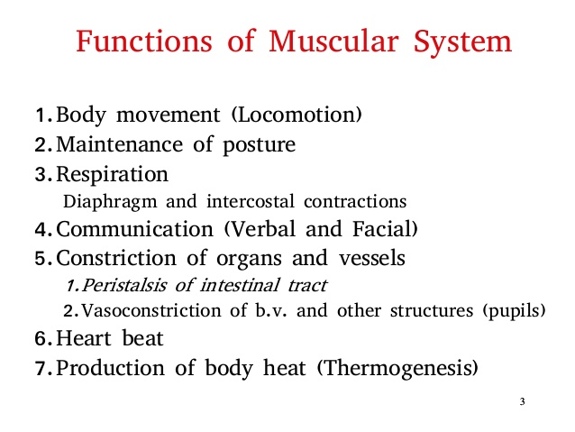

Slide 31
LYMPHATIC SYSTEM
It is made up of a large network of lymph, lymphatic vessels, lymph nodes, lymphatic or lymphoid organs, and lymphoid tissues
It is a part of your immune system
The lymphatic system clears away infection and keeps your body fluids in balance
Tonsils, Spleen, thymus gland, bone marrow

Slide 32
RESPIRATORY SYSTEM
It is a system mainly responsible for gas exchange in the body.It is made up of
Nose,Mouth,Throat,Voice box,Windpipe (trachea),Large airways (bronchi),Lungs.
Place where blood receives oxygen for various body functions & metabolism & gives out carbon dioxide as waste.

Slide 33
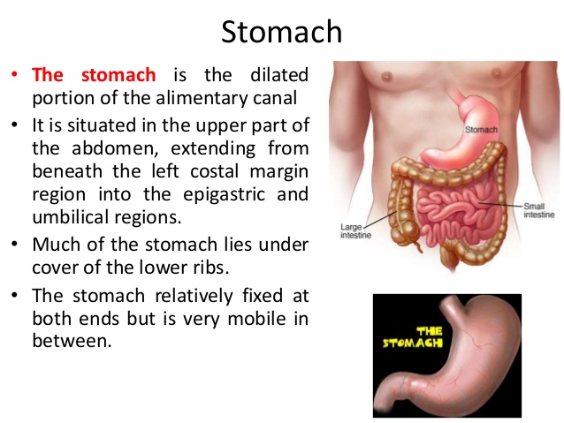
DIGESTIVE SYSTEM
Consists of mouth,
Oesophagus (upper part of digestive system)
Stomach
Small intestine,Large intestine
Rectum (lower part of digestive system)
Anus
Liver (Produces bile .Liver breaks down most of the alcohol you drink so that it can be removed from the body– alcoholic liver cirrhosis)
Gall Bladder (Stores the bile)
Pancreas(produces enzymes which help in digestion & secretes hormone insulin for blood sugar control)

Slide 34
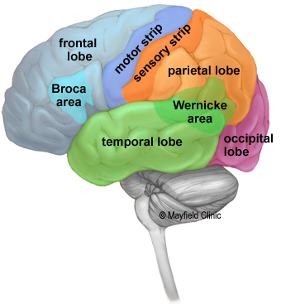
NERVOUS SYSTEM
Made up mainly of 2 parts Central nervous sytem (brain & spinal cord) & Peripheral Nervous sytem the nerves network which fans out from the spinal cord)
Receives information about the environment around us (sensation) and generates responses to that(motor responses)

Slide 35
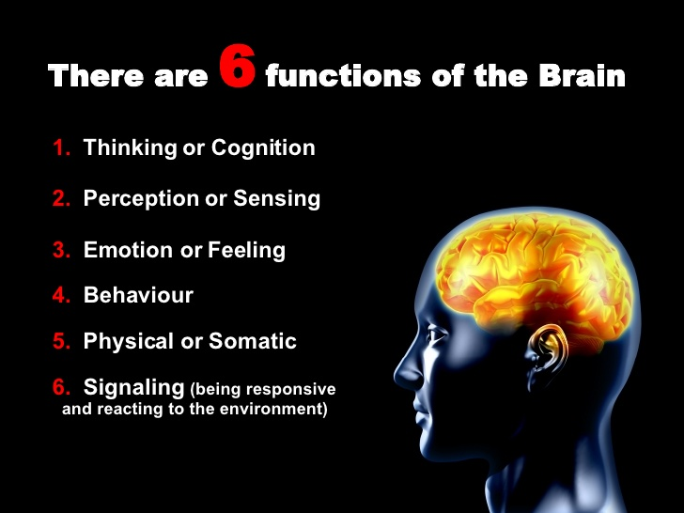

Slide 36
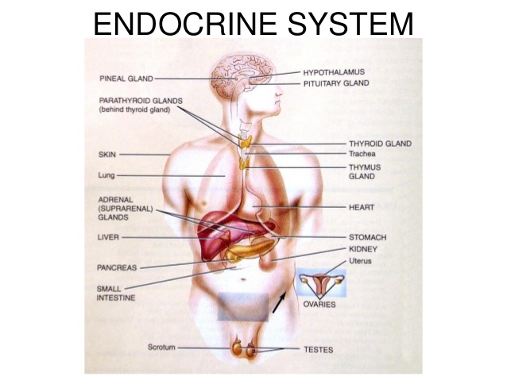
ENDOCRINE SYSTEM
Consists of --
Hypothalamus
Pineal Gland
Pituitary Gland
Thyroid
Parathyroid
Thymus
Adrenal
Pancreas

Slide 37
There are many functions of the Endocrine functions but few important are :
Metabolism.
Growth and development.
Sexual function and reproduction.
Heart rate.
Blood pressure.
Mood Control etc
Harmones

Slide 38
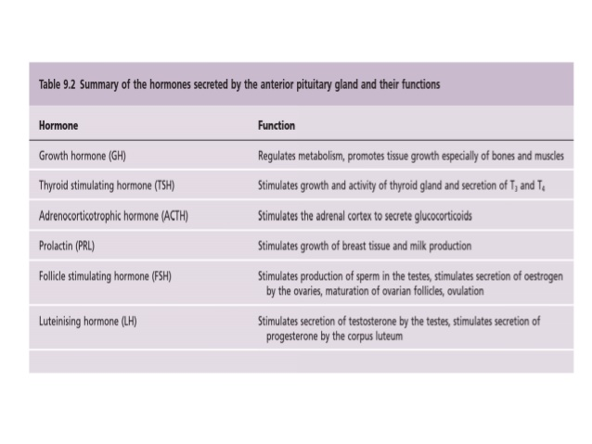

Slide 39
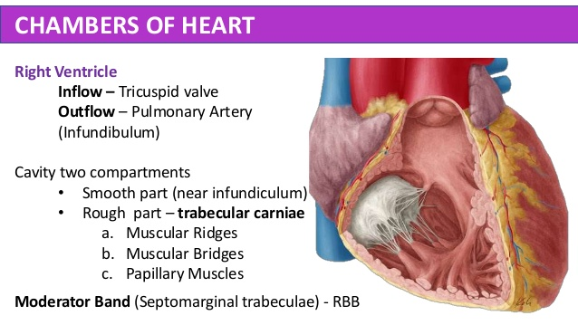
CARDIOVASCULAR SYSTEM
Maintenance of constant body temperature (thermoregulation) ...
Circulates OXYGEN and removes Carbon Dioxide.
Provides cells with NUTRIENTS.
Removes the waste products of metabolism to the excretory organs for disposal.

Slide 40
Urinary system
Consists of Kidneys, ureters, bladder and urethra.
Main functions
Remove waste products from the body.
Remove drugs from the body.
Balance the body's fluids.
Release hormones that regulate blood pressure.

Slide 41
Reproductive system
The reproductive system is a collection of internal and external organs — in both males and females — that work together for the purpose of procreating.
Plays a vital role in the survival of the species taking the race forward.

Slide 42
Communicable diseases
Respiratory infections

Slide 43
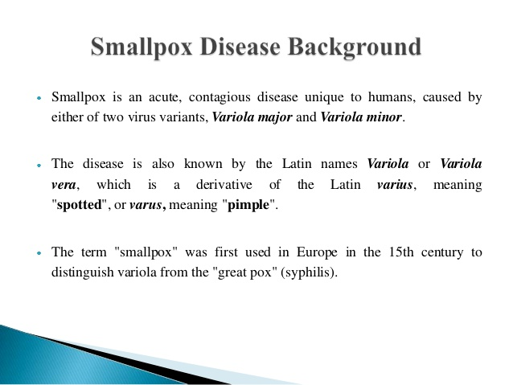

Slide 44
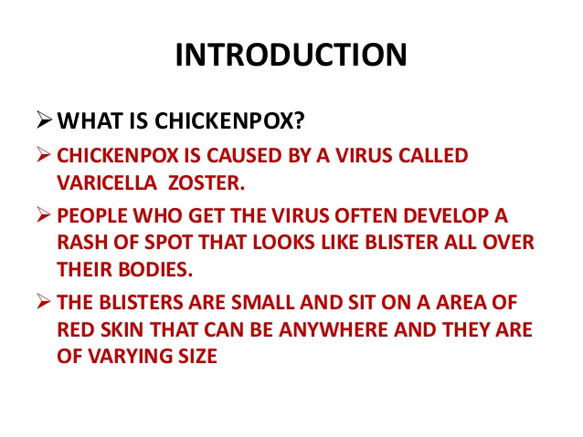

Slide 45
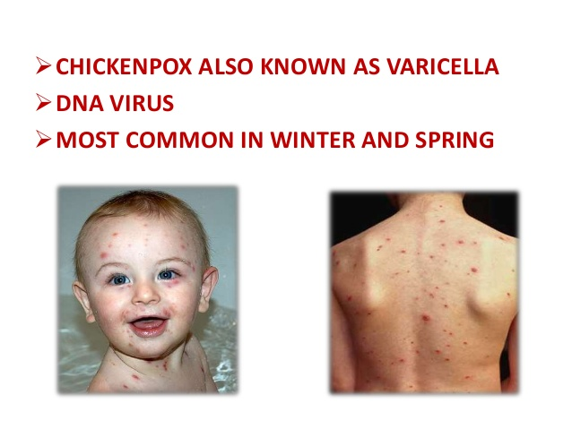

Slide 46
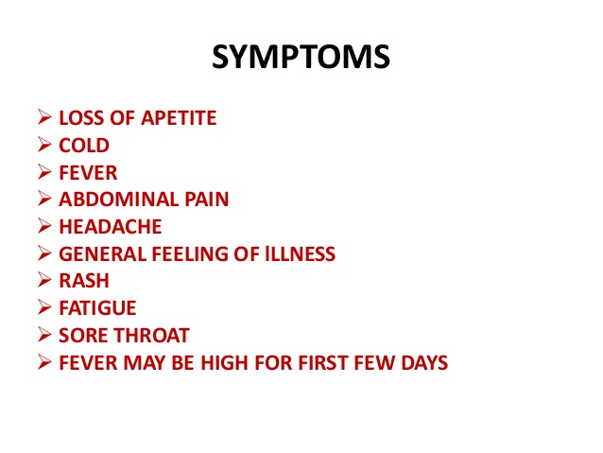

Slide 47
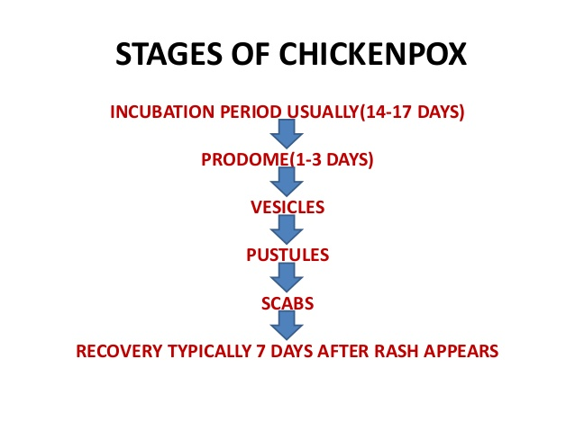

Slide 48
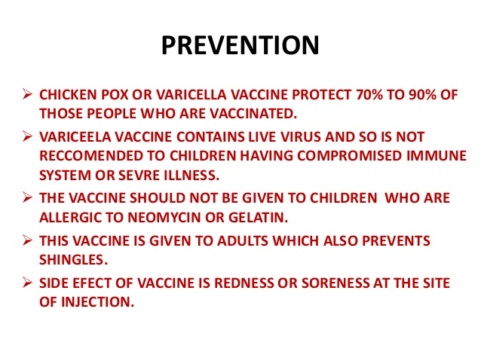

Slide 49
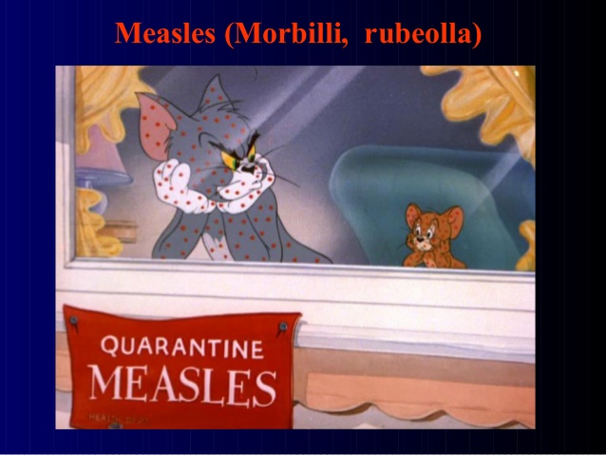

Slide 50
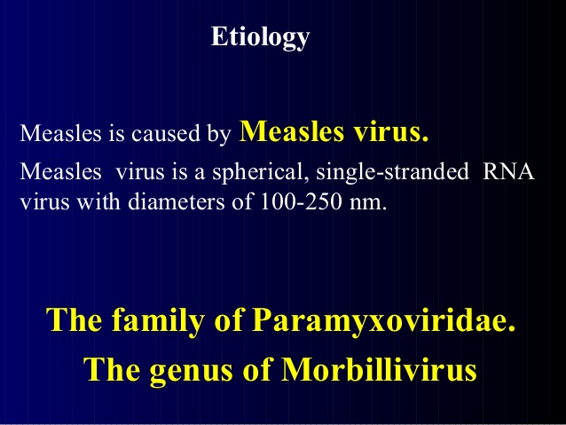

Slide 51
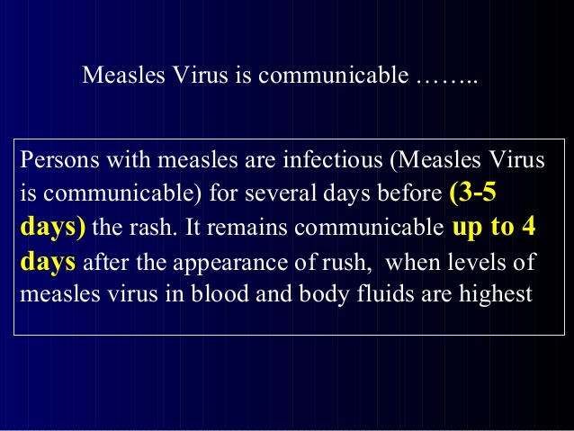

Slide 52
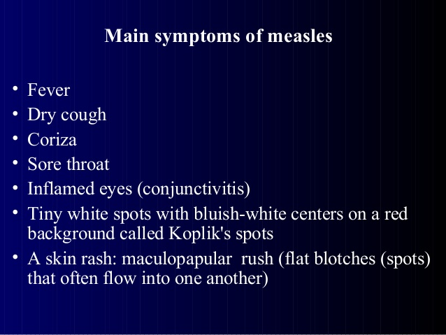

Slide 53
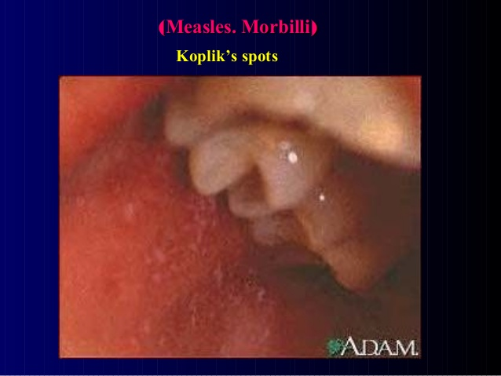

Slide 54
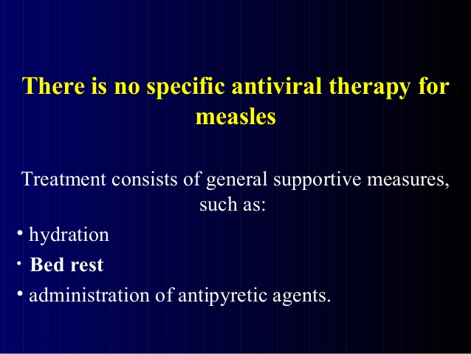

Slide 55
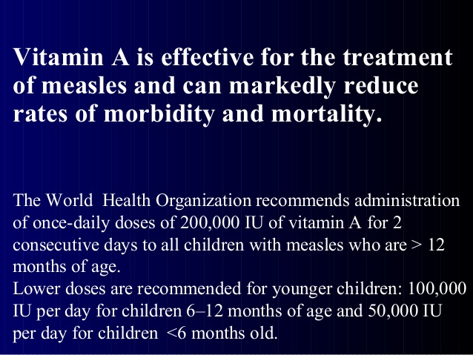

Slide 56
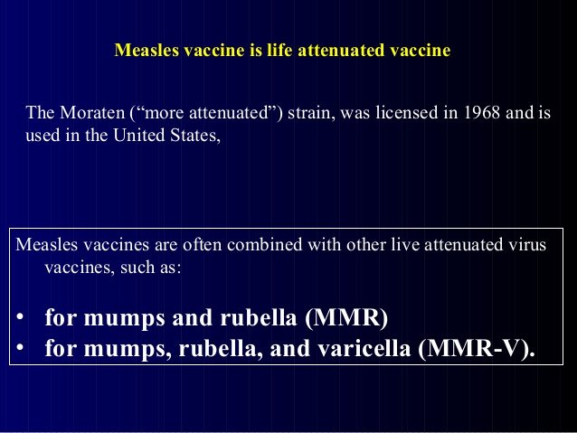

Slide 57


Slide 58
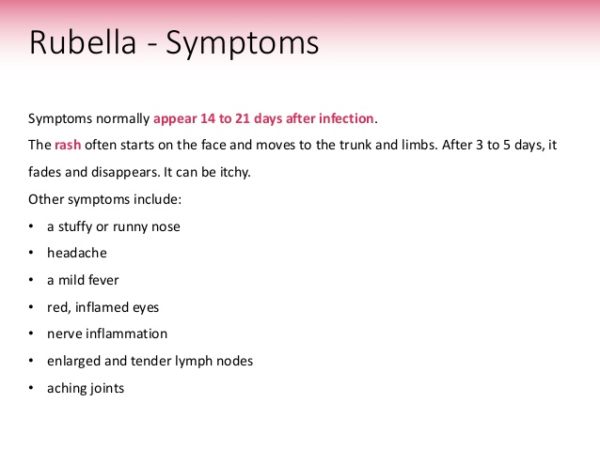

Slide 59
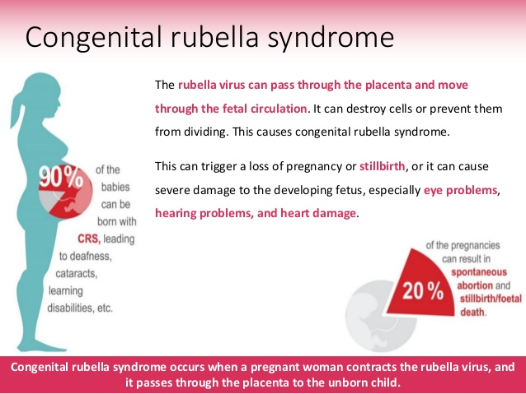

Slide 60
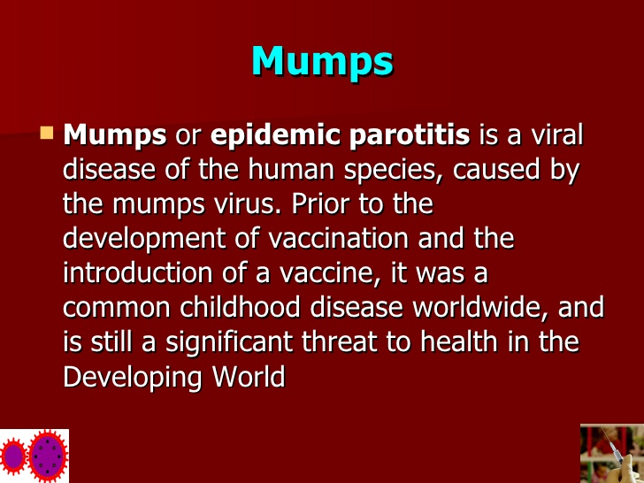

Slide 61
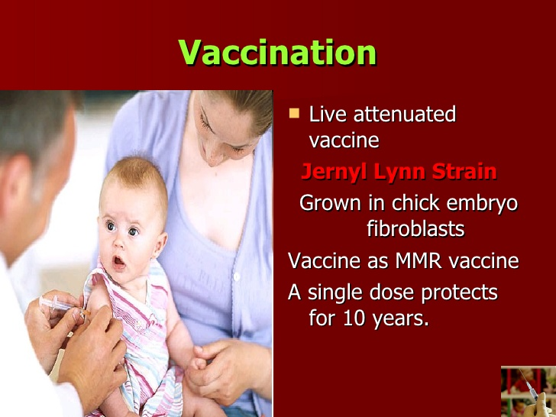

Slide 62
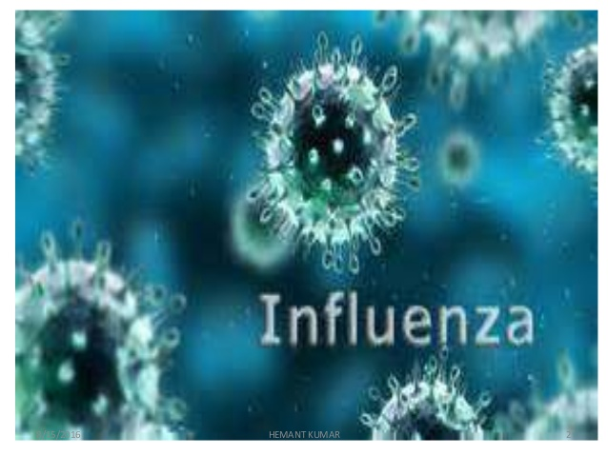

Slide 63


Slide 64


Slide 65


Slide 66


Slide 67


Slide 68


Slide 69


Slide 70


Slide 71


Slide 72


Slide 73


Slide 74


Slide 75


Slide 76


Slide 77


Slide 78


Slide 79


Slide 80


Slide 81


Slide 82


Slide 83


Slide 84


Slide 85



Slide 86
https://www.youtube.com/watch?v=5DGwOJXSxqg
Notes:
Covid video

Slide 87


Slide 88


Slide 89


Slide 90


Slide 91


Slide 92


Slide 93


Slide 94


Slide 95


Slide 96


Slide 97


Slide 98


Slide 99


